Slide 1
Delocalization-localization Transition of Plasmons in Random GaAs/AlGaAs Superlattices
Y.A.Pusep
Institute of Physics of São Carlos, University of São Paulo
Collaborators:
Experiment – A.D.Rodrigues, UFSCar.
Theory - S.S.Sokolov, B.Verkin Institute for Low-Temperature Physics and Engineering, National Academy of Sciences of Ukraine.
Samples – H.Arakaki, C.A. de Souza, IFSC/USP.

Slide 2
Motivation
Why plasmons ?
Optical fibers versus electrical circuits. Diffraction limit.
Advantages of optical and electrical circuits:
Fast data transfer by transmitting optical signals through
minuscule nanoscale structures .
Manipulation of plasmons (localization and propagation).
Notes:
Optical fibers transfer much more information signals and much faster than electrical circuits. However, the size and performance of photonic devices are constrained by the diffraction limit – interference between closely spaced light waves must be avoided by placing them on a distance larger than half the light´s wavelength (compare 1.5 mcm with a typical transistor size of about 100 nm).
Plasmons present an alternative way to transfer optical signals through an electron system (advantages of optical and electrical circuits: fast transfer and small size).
Resonant interaction between the light wave and the electrons located at the metal-dielectric interface – the interface plasmons with the frequency of the light but with a much shorter wavelength.

Slide 3




Electrons and Plasmons
1. Electrons: single-particle excitations
2. Plasmons: collective excitations
Notes:
The higher frequency, the more information transferred. Both the dynamical conductivity and the dielectric function describe response of the electrons to external electric field. Imaginary part of the electron conductivity results in additional resistance.
Imε(ω) = σ(ω)/ωεo

Slide 4
Outline
Random superlattices
Raman scattering by collective excitations
Plasmon localization: theory and experiment
Conclusions

Slide 5
Artificially disordered superlattices
Notes:
Influence of the SL potential on both electrons and plasmons.

Slide 6

Criterion of Localization
metal (kFl>1):
σ (ω = 0, T = 0) ≠ 0, ∂σ/∂T < 0
Electrons
insulator (kFl<1):
σ (ω = 0, T = 0) = 0, ∂σ/∂T > 0
Obs: l is the electron free path length, kF = 2π/λe,
λe is the electron wavelength.

Slide 7
Criterion of Plasmon
localization - ?

Slide 8





Theory of plasmon localization
Plasmon wave function:
Neutral impurity scattering potential:
Results of calculations
with
Notes:
The plasmons are represented as quasi-particles. In heavily doped semiconductors the main contribution to the plasmon localization (Lc) comes from the interaction with the Coulomb potential of ionized impurities, while the interaction with the impurity core (treated as the scattering by neutral impurities) does not significantly affect the plasmon localization length and may be considered as a perturbation influencing the plasmon linewidth (plasmon damping).
Theta(Ro-r) – is the Heaviside step-function (1 at Ro<r, and 0 at Ro>r).

Slide 9
Criteria of Plasmon localization
1. Plasmon damping (Гp) independent of
disorder parameter (Lc, δ) indicates localization.
2. Relation between Lc and R0
determine propagation of plasmons:
Localized plasmon: Lc < R0
Delocalized plasmon: Lc > R0

Slide 10
Raman scattering of plasmons in presence of disorder
Non-conservation of quase-momentum
[Yu.A.Pusep, et al., Phys.Rev.B 58, 10683 (1998)]:
Notes:
Raman scattering directly probes the wave function of plasmon.

Slide 11
Doped superlattices
(weak plasmon localization)
Disordered superlattices
(strong plasmon localization)
Lc > R0
Lc < R0
Notes:
Doped periodic SLs – quasi-elastic scattering by ionized impurity mostly affects the spatial localization of plasmons (weak localization limit).
DSLs – inelastic scattering by disordered potential (neutral impurity scattering) results in strong plasmon localization.
T=250K - Ro = 20 nm, Uo = 60 meV.

Slide 12
Temperature Effect
Weak plasmon localization:
(plasmonic “metal”)
Lc > R0
Strong plasmon localization:
(plasmonic “insulator”)
Lc < R0

Slide 13
Conclusions
The independence of the plasmon linewidth on disorder is the manifestation of plasmon localization.
Delocalized plasmon: Lc > Ro – the increasing disorder results in increasing plasmon linewidth;
Localized Plasmon: Lc < Ro – no influence of the disorder on plasmon linewidth;
The increasing temperature enhances the localization of the
weakly localized plasmons, while it causes the delocalization
of the strongly localized plasmons.
Yu.A.Pusep, A.D.Rodrigues, S.S.Sokolov, Phys.Rev.B 80, 205307 (2009).
Notes:
The considerable influence of the disorder on the plasmon linewidth was detected for weak plasmon perturbation Lc>Ro, which is the case of the doped periodic SLs studied here where the inelastic scattering of plasmons by impurity cores is weak. While, the insignificant effect of disorder on the plasmon linewidth was found in the random SLs where a strong disorder causes the plasmon localization within the length Lc<R0. The independence of the plasmon damping on disorder is considered as a manifestation of the plasmon localization.

Slide 14
Thank you!

Slide 15
Raman line shapes (q=0)
Damped plasmon:
Overdamped plasmon:
Raman line shapes (q≠0)
Non-conservation of
the quase-momentum:
Notes:
The characteristic features of the overdamped plasmon are: the pining of the coupled plasmon-LO phonon modes at the frequency of the TO phonon and the upward Raman line asymmetry.
We used a fact that disorder results in asymmetry of the Raman lines associated with the collective excitations. This asymmetry is caused by a non-conservation of the quasi-momentum. Non-conservation of the quasi-momentum mixes modes with different k. The shape of the Raman lines depends on the localization length and on the dispersion of the relevant excitations.
Thus, Raman scattering directly probes a wave-function of collective excitations [Merlin].
Considering the simple model - the phonons localized in the spheres of the diameters Li. These phonons are characterized by the frequencies Omega(i) and the dampings (homogeneous broadenings) Gamma(i) = Gamma (because of the homogeneity). In this case the wave numbers of the phonons are determined by the sizes of the spheres rather than by the wave number of the light. Thus, the phonon modes with different wave numbers (and consequently, different frequencies) contribute to the Raman line, which therefore reflects the phonon density of states. Lp is the characteristic localization length which is determined by the Gaussian distribution of the sphere sizes.

Slide 16
Raman scattering in disordered GaAs/AlGaAs superlattices
Notes:
The characteristic features of the overdamped plasmon (the pining of the coupled plasmon-LO phonon modes at the frequency of the TO phonon and the upward Raman line asymmetry) are clearly presented in DSLs with highest disorder.

Slide 17
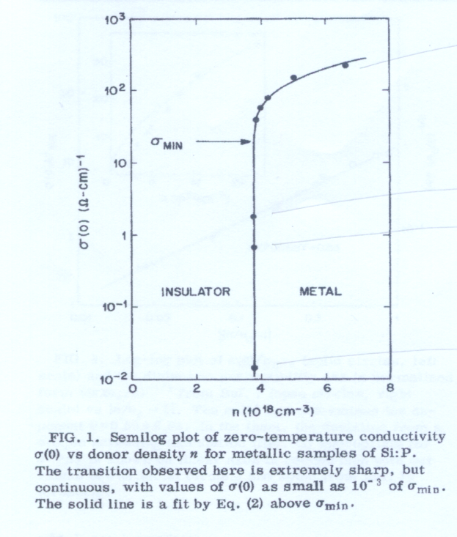
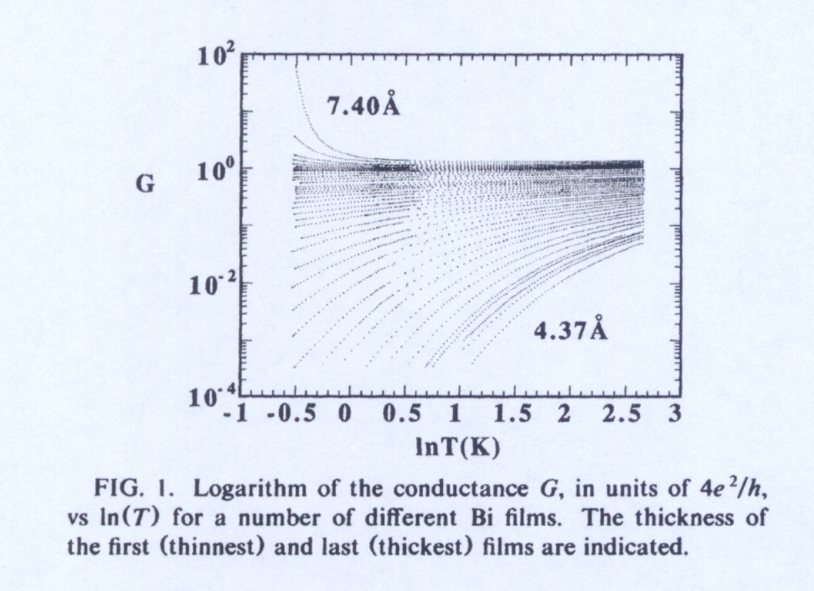
Criterion of Localization
metal (kFl>1):
σ (ω = 0, T = 0) ≠ 0, ∂σ/∂T < 0
Electrons
insulator (kFl<1):
σ (ω = 0, T = 0) = 0, ∂σ/∂T > 0
Y.Liu, et al., Phys.Rev.Lett. 67, 2068 (1991)
T.F.Rosenbaum et al., Phys.Rev.Lett. 45, 1723 (1980)

