Slide 1
APPLICATION OF DIFFERENT MATERIALS IN BONE IMPLANTOLOGY
BRUNO KÖNIG JÚNIOR
SÉRGIO ALLEGRINI JUNIOR

Slide 2
SIX KINDS OF CALCIUM PHOSPHATE CERAMICS WERE INSTALLED IN THE RABBIT’S TIBIAE: CaHPO₄, Ca(HPO₄)₂H₂O, Ca₂P₂O_{7,} Ca₃(PO₄)₂ Ca₉(PO₄)₆(OH)₂, and Ca₁₀ (PO₄)₆(OH)₂, .
The fluorescense microscopy was used in order to observe the periodic osteoconduction/deposition properties of the different ceramics of calcium phosphate. The animals were subcutaneously injected with fluorescent apatite labeling chemicals.
Alizarin was injected in the 2nd and 3rd , calcein in the 4th and 5th and tetracycline in the 6th and 7th postoperative weeks. Sacrifice took place in the 8th week.
The technique used for calcified tissue histologic preparation is the one developed by Karl Donath from the Hamburg University (Donath, K. Die Trenn-Dünnschliff-Technik zur Herstellung histologischer Präparate von schneidbaren Geweben und Materialen. Der Präparator, 34: 197-206, 1988).

Slide 3
GRAFT
CaHPO₄ (Dicalcium anhydrid phosphate) – Photomontage of a rabbit’s tibia transverse section in fluorescence microscopy. The fluorescent labels Alizarine (2nd and 3rd weeks after surgery – brick red in color), Calcein (4th and 5th weeks after surgery – yellow green in color) and Tetracycline (6th and 7th weeks after surgery – orange in color) indicate different periods of calcium deposition. 10X in the microscope.
KÖNIG & RESEARCH TEAM

Slide 4
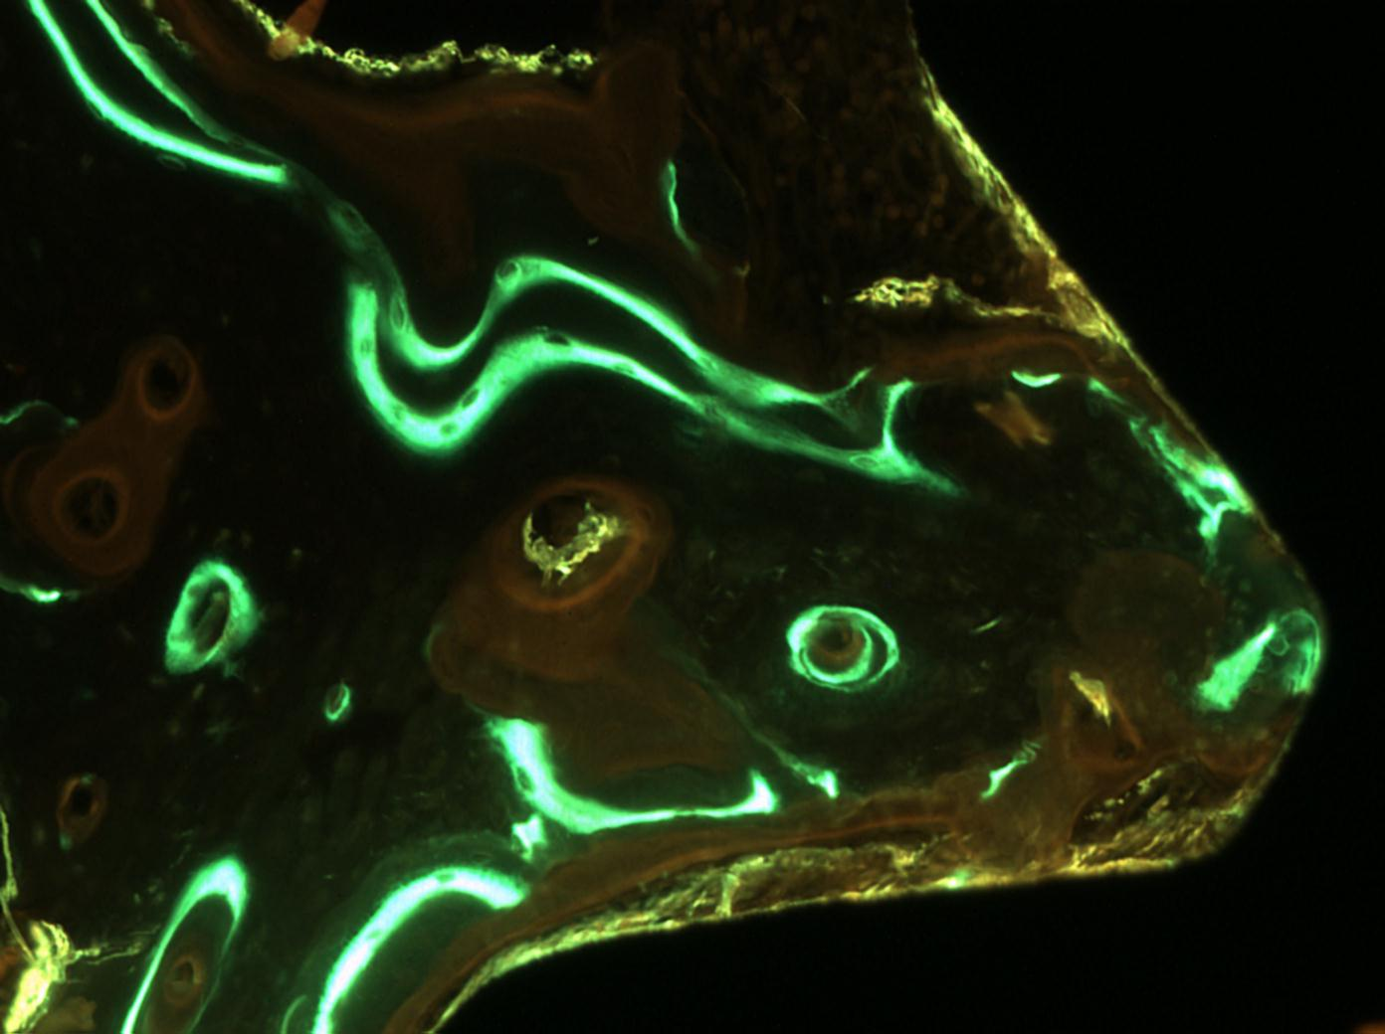
TITANIUM
IMPLANT
B
C
A
T
Ost
Cr
Cr
Fluorescent photomicrograph of a titanium implant covered with anhydrid phosphate calcium ceramic (CaHPO4) showing different periods of calcification enhanced by different colors. Great activity in the alizarin and calcein periods. B = mature bone, Ost = Osteon, A = Alizarin, C = Calcein, T = A tetracycline osteonic ring and Cr = Ceramic . 100X in the original.
KÖNIG & MITRI

Slide 5
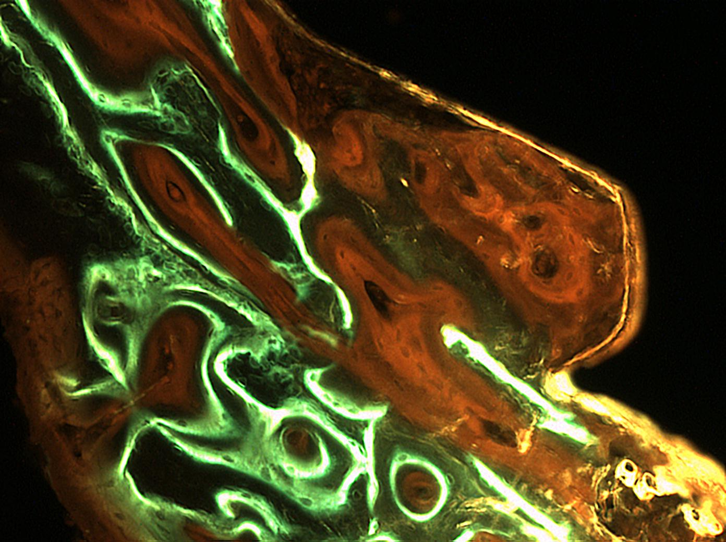
TITANIUM
IMPLANT
A
T
Cr
Fluorescent micrograph with a titanium implant covered with a dicalcium dihydrated
ceramic (CaHPO42H2O) showing different periods of calcification enhanced by different
colors. There is a great amount of newly formed bone tissue. A = Alizarin; C = calcein;
T = Tetracycline and Cr = Ceramic. Less calcification was observed in the alizarin period,
that is in the beginning of the deposition process. 100X in the microscope.
C
KÖNIG & MITRI

Slide 6
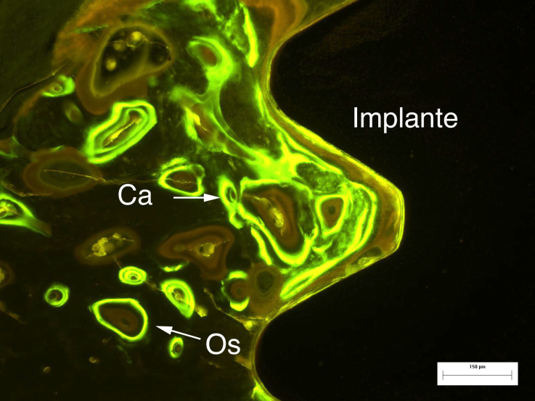
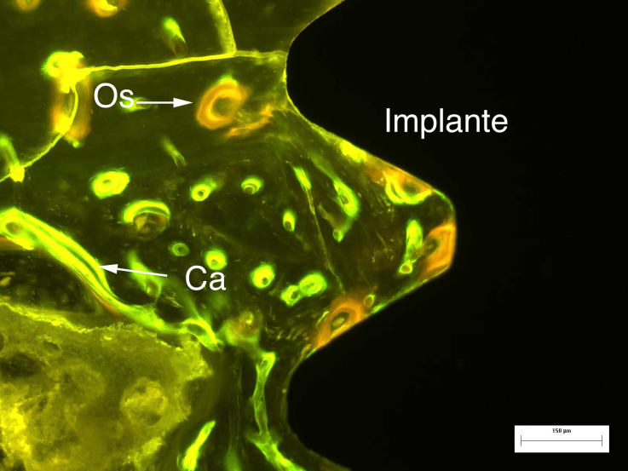
TITANIUM
IMPLANT
TITANIUM
IMPLANT
A
B
Osteoconduction results of titanium implants coated with pyrophosphate calcium ceramic - Ca2P2O7.
A - Photomicrography of the control group under fluorescent light. The thread of the implant screw is fulfilled with concentric or parallel lamellar bone with a predominance of calcein labeling. (Ca = calcein, Os = osteon), bar = 150 μm.
B – Photomicrograph of the experimental group under fluorescent light. A predominance of calcein labeling, but with a lesser amount, is to be seen. (Ca=calcein, Os = osteon), bar = 150 μm.
KÖNIG & KOO

Slide 7
EXPERIMENTAL GROUP
CONTROL GROUP
Ca2P2O7
KÖNIG & KOO

Slide 8
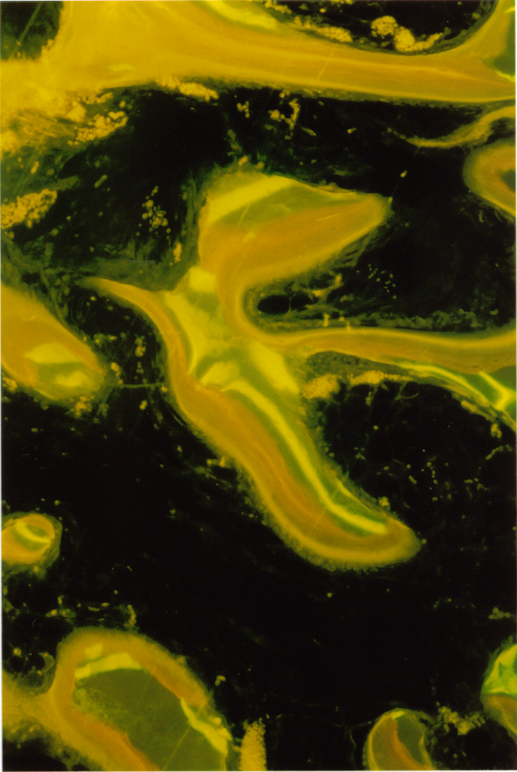
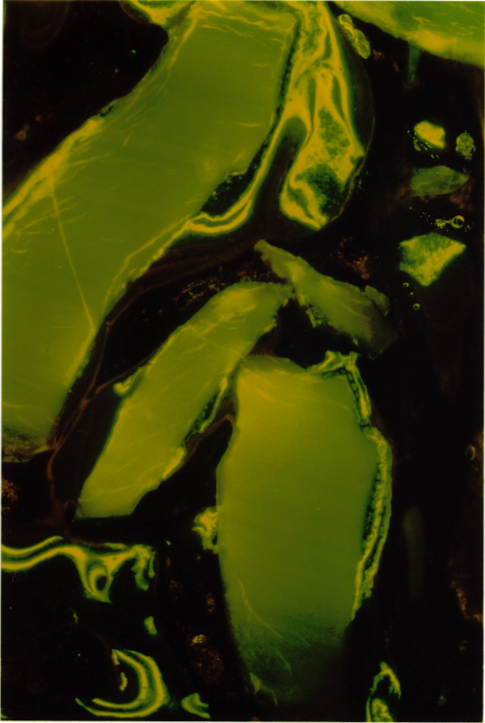
Three phases of fluorescence of calcification periods in a dental alveolar cavity after tooth extraction grafted with reabsorbable Hydroxyapatite (HA) Ca₉(PO4)₆(OH)₂ 30X in the original.
Image of fluorescence microscopy of a dental alveolar cavity after tooth extraction grafted with not absorbable HA Ca₁₀(PO₄)₂(OH)₂. A few mineral depositions are to be seen among ceramic crystalloids. 30X in the original.
KÖNIG & DE MELO

Slide 9
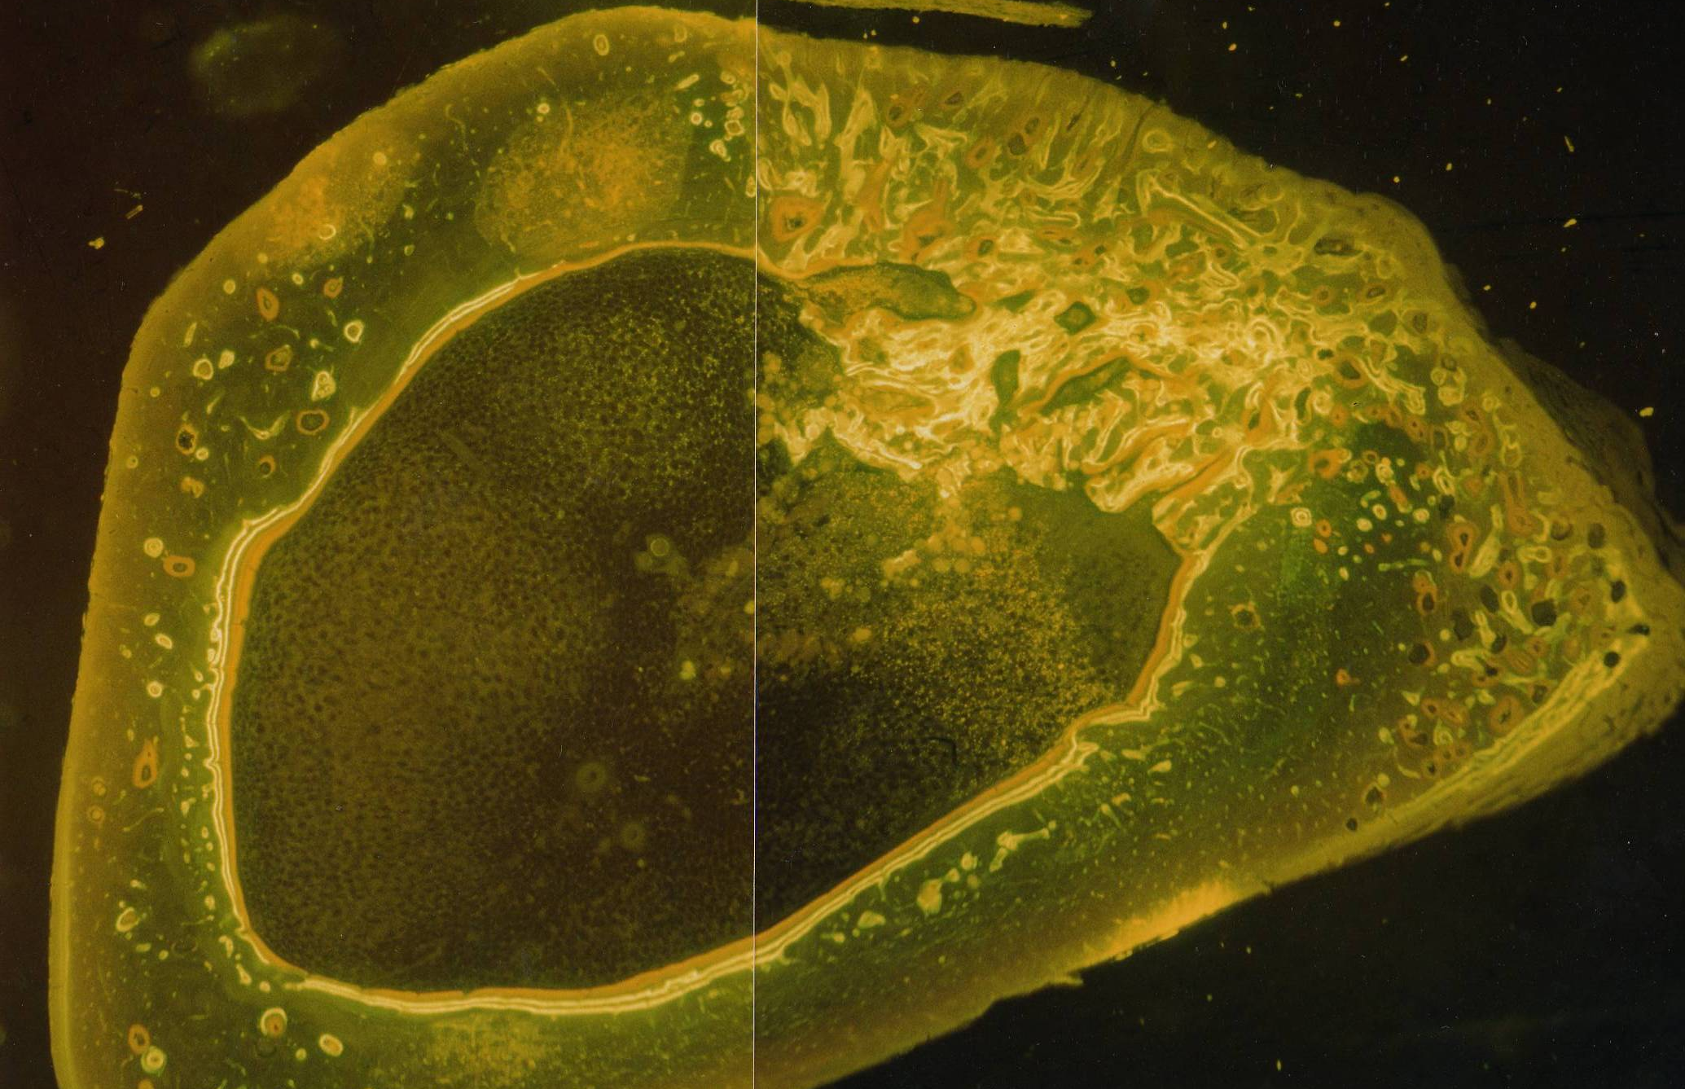
Ca₃(PO₄)₂- Photomontage of a transverse section in fluorescent microscopy of rabbit tibia. Great repair activity areas with bone cortical tissue neoformation (bone remodeling) in the graft insertion area. There are still many granules of the ceramic to be seen after 8 weeks of post operatory time, in the bone marrow region. Layers of bone deposition in the endostal region.10X in the microscope.
KÖNIG & RESEARCH TEAM

Slide 10
CERAMIC BONE DEPOSITION AREA (IN µm² ) % CLASSIFICATION
Ca HPO₄ | 152.108,00 | 12,18 | 5TH
Ca(HPO₄)₂H₂O | 162.919,54 | 13,04 | 4TH
Ca₂P₂O₇ | 228.813,85 | 18,32 | 3TH
Ca₃(PO₄)₂ | 278.370,96 | 22,28 | 2ND
Ca₉(PO₄)₆(OH)₂ | 99.295,03 | 7,95 | 6TH
Ca₁₀(PO₄)₆(OH)₂ | 327.760,07 | 26,24 | 1ST
TOTAL | 1.249.267,45

Slide 11
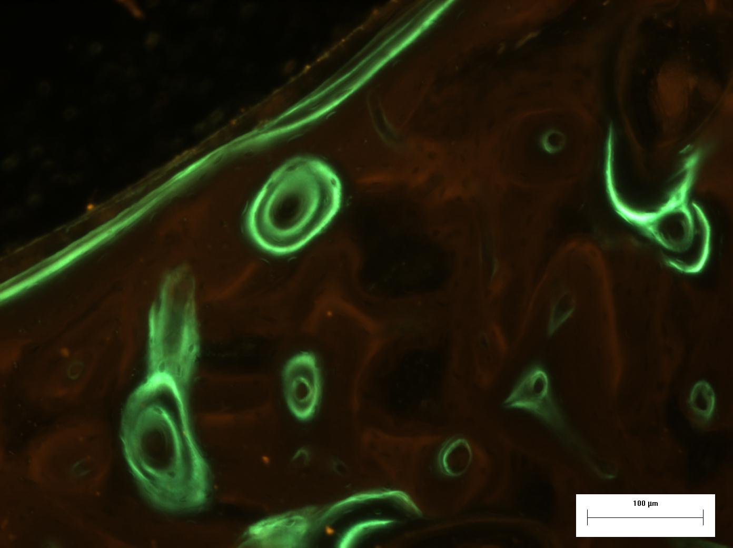
USE OF BIOACTIVE GLASSES COMPOSED OF PHOSPHATES CONTAINING CALCIUM, SODIUM AND NIOBIUM. MARCELO J. CARBONARI.
IMPLANT
C
LT
OS
C
A
T
Fluorescent micrograph of a bone remodeling and conduction area. Labeling is present – tetracycline (T), alizarin (A) and calcein (C). Osteons (OS) and lamellar parallel bone tissue (LT).
CARBONARI, MARTINELLI & KÖNIG

Slide 12
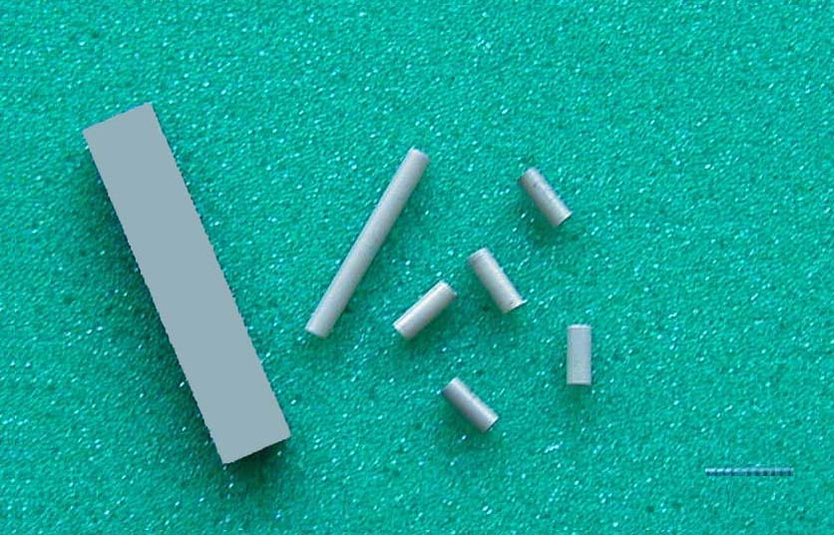
BIOCOMPATIBILITY OF SILICON NITRIDE IMPLANTS – Cecilia Chaves Guedes e Silva
1
3
2
Samples of silicon nitride: 1) initial form; 2) after correction and 3) samples to be used “in vivo” testing.
GUEDES E SILVA, BRESSIANI & KÖNIG

Slide 13
GUEDES E SILVA, BRESSIANI & KÖNIG
Deflection of a split among pellets of β-Si₃N₄ (arrow).

Slide 14
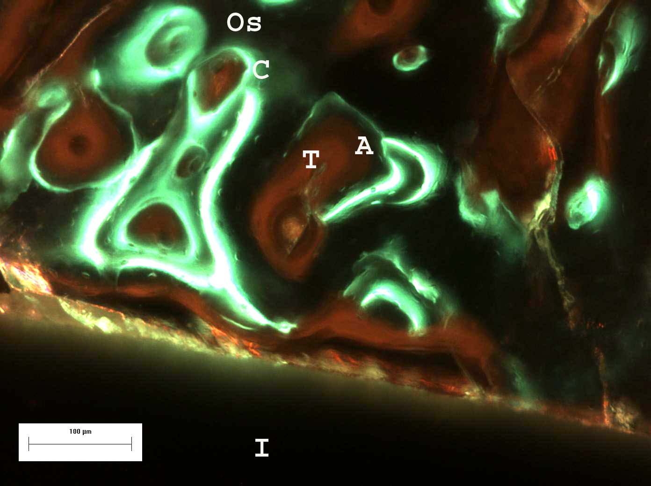
OS – OSTEON
A – ALIZARIN
C – CALCEIN
T – TETRACYCLINE
I - IMPLANT
The Si₃N₄ ceramic shows itself biocompatible and osteoconductive.

Slide 15
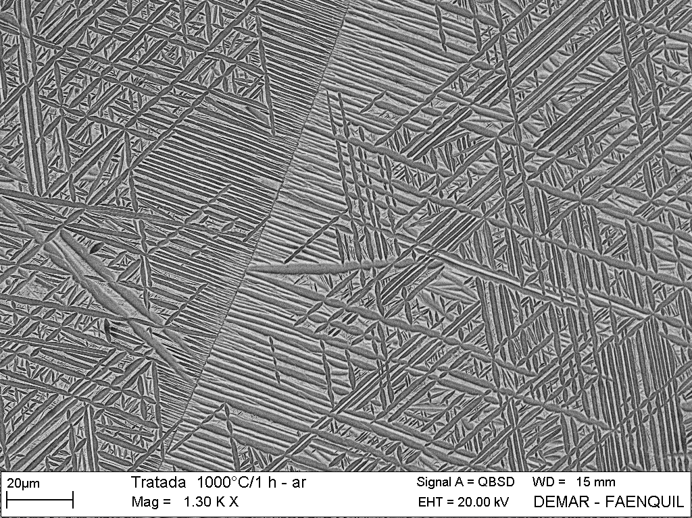
Osteointegration of the Ti-13Nb-13Zr alloy to be used as a biomaterial.
Sandra J. Schneider
SCANNING ELECTRON MICROGRAPHIE OT THE ALLOY.
SCHNEIDER, BRESSIANI & KÖNIG

Slide 16
MATURE BONE
OSTEOCONDUCTION
OF NEWLY FORMED
BONE
ISLANDS OFBONE
REMODELING
PERIOST
Ti-13Nb-13Zr
IMPLANT
FLUORESCENT MICROGRAPH SHOWING THE BIOINTEGRATION OF THE IMPLANT. SCHNEIDER, BRESSIANI & KÖNIG

Slide 17
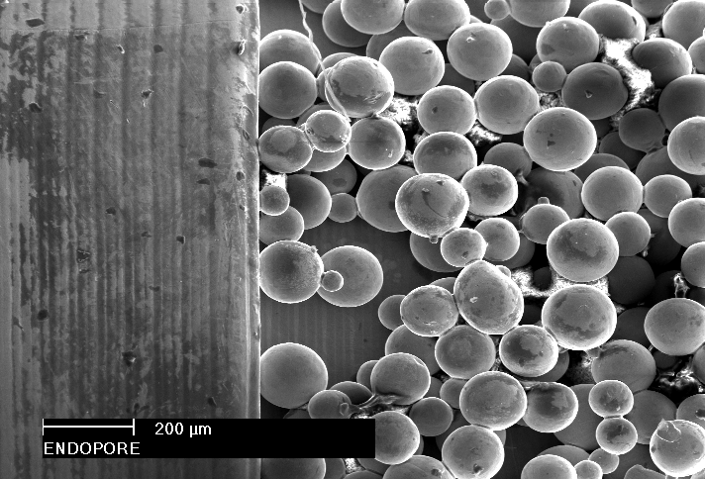
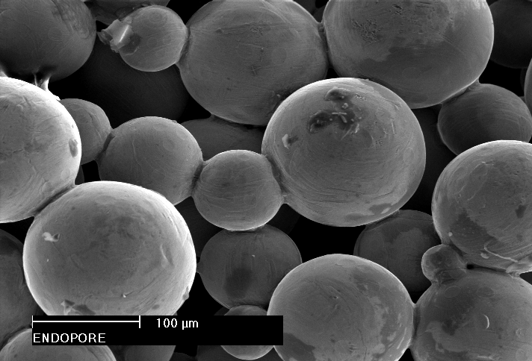
Osteointegration of the Ti-13Nb-13Zr alloy obtained by powder metallurgy.
Marco Cícero Martins Bottino.
*
*
Scanning electron microscopy of an Endopore Implant (Innova Corporation, Toronto, ON, Canada), as example: Different magnifications to show porosity.

Slide 18
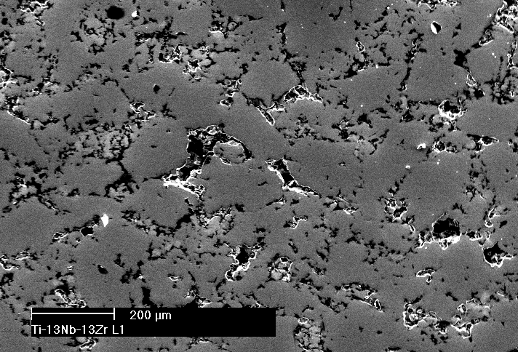
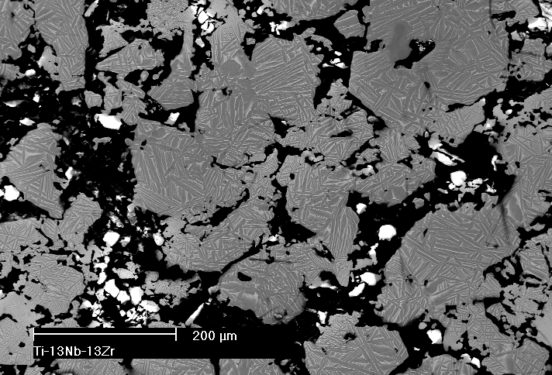
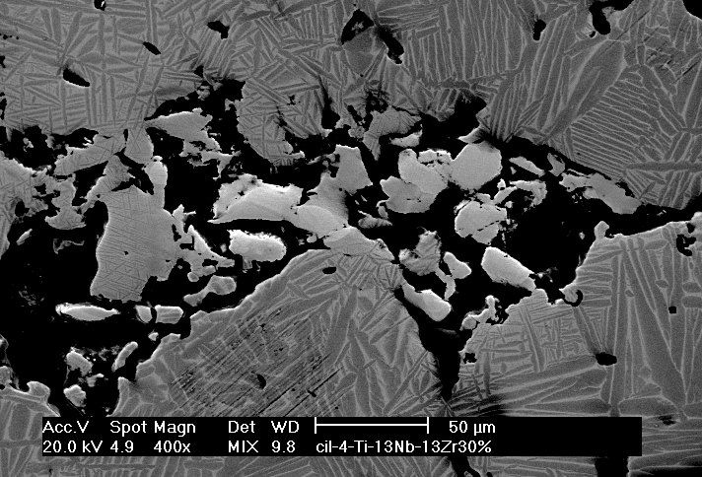
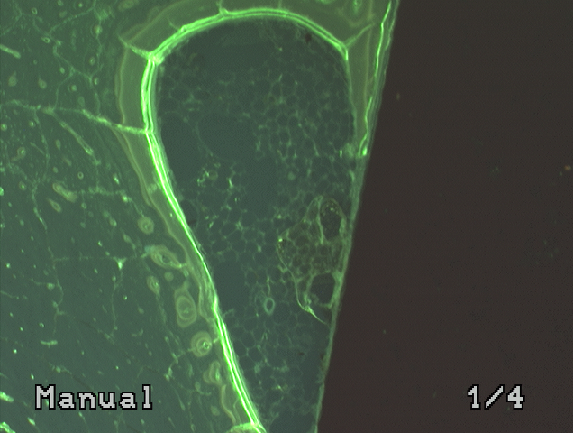
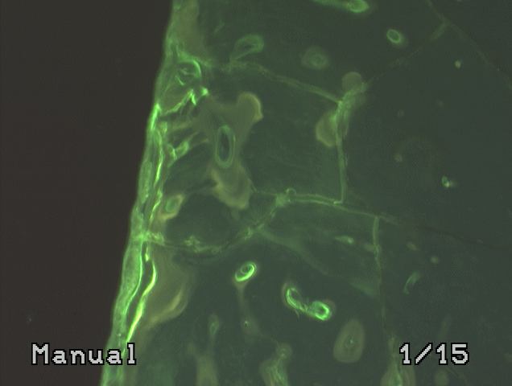
I
I
Micrographies, obtained by SEM, of the Ti-13Nb-13Zr alloy samples in different magnifications. Clear regions are not diluted Nb particles. Interconnections of the alloy pores. In the color slides it is to see that osteointegration and osteoconduction were achieved. BOTTINO, BRESSIANI & KÖNIG

